Slide 1








OLAM GLOBAL AGRI PERU
Rice market

Slide 2
INDEX
Local Production:
Production
Consumption
Packing
Distribution
Costs & Prices
Imported rice:
Volume
Packing
Distribution
Costs & Prices

Slide 3

LOCAL PRODUCTION
3

Slide 4
OVERALL
Peru consumption: +2.3 million tons per year with 61Kg per capita
Local production: 2 million tn/year
Imported: 200k MT - 10% Uruguay & Brazil
Main considerations:
Informal market of seeds, commercialization, taxes, among others.
Lack of homogeneous quality and certifications.
Lower margin average 5%
Peruvian Production and Consumption
YEAR | DOMESTIC PRODUCTION (tn) | IMPORTATIONS (tn) | EXPORTATIONS (tn) | TOTAL DOMESTIC CONSUMPTION (tn)
2022 | 2,153,564 | 116,297 | 19,630 | 2,250,232
2021 | 2,404,524 | 233,268 | 729 | 2,637,063
2020 | 2,335,256 | 315,586 | 45,281 | 2,605,562
2019 | 2,169,859 | 292,697 | 37,091 | 2,425,465
2018 | 2,419,372 | 271,511 | 372 | 2,690,512
2017 | 2,118,570 | 401,832 | 178 | 2,520,225
2016 | 2,152,709 | 290,300 | 8,624 | 2,434,385
4

Slide 5
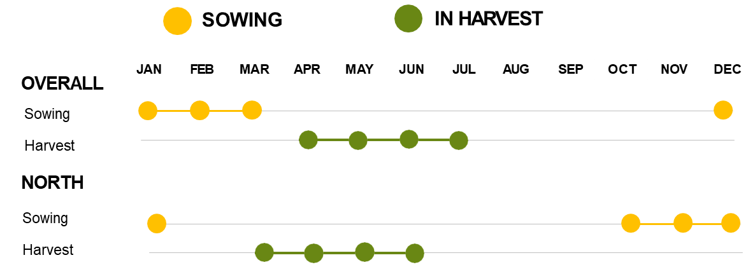
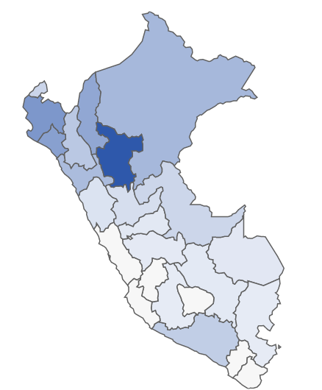
FIELD PRODUCTION
PERUVIAN PRODUCTION
FIELD COST
40%
1,155k
30%
887k
10%
280k
Tn | 2,978,133
N° ha | 410,000
Yield Tn/ha | 7,500
N° farmers | 14,000
Irrigation | 15,000m³/ha
5

Slide 6






30-40 in Peru
Collect, process & pack
PROCCESSING – MILLS
Lack of work capital
Charge in cash
Advance to farmers money or seeds.
Processing MP 70kg --> 50Kg - Variety EXTRA
COSTS | MIN | MAX
Cost Raw Material | $ 28.95 | $ 31.05
Freight from the field + stowage | $ 0.53 | $ 0.53
Drying (incl stowage) | $ 0.61 | $ 0.71
Processing | $ 2.37 | $ 2.76
Añejado | $ 2.89 | $ 2.89
Cost until Mill | $ 35.34 | $ 37.95
Transport to Lima | $ 1.66 | $ 2.37
Cost of bag 50Kg | $ 37.00 | $ 40.32
Cost per Kg | $ 0.76 | $ 0.82
No certifications (No HACCP, BRC, etc)
Basic docs:
Health Register
Operating license
Retail: 750g – 5kg
Bulk: 49Kg – 50Kg
Delivery to Mercado de Productores (bulk)
Pack to supermarkets (retail)
Distribution to regions (No Lima) (bulk)
Raw material: 3 years
Final product: 3 months
6

Slide 7
RICE QUALITY
Quality | Features | % Consumption | Estimated MT | Applications | Comments
Añejo | 0% - 4% | 5% | 112,500 | Restaurates, chifas, grained well, grows well, better flavor. | It receives an additional dehydrated process, that reduces the weight but when it's cooked it multiplies.
 | broken grain
Extra | 0% - 4% | 15% | 337,500 | Own brand, supermarket brand. Bulk in markets. | Grained well, good flavor, preferred by end customers looking for quality.
 | broken grain
Superior | 5% - 15% | 40% | 900,000 | Own brand, supermarket brand. Bulk in markets, biggest consumption. | Acceptable quality, by customers looking for lower price.
 | broken grain
Corriente (Ordinary) | 16% - 25% | 25% | 562,500 | Not use for private brands, mostly bulk sells in bulk. | Mix of different qualities, example jungle with superior.
 | broken grain
Jungle |  | 15% | 337,500 | Use to mix with other qualitites, Lower quality, glue after cooked, gets hard when it gets cold. | Direct consumption in the jungle. In scarcity north mills buy to mix with their rice. Some lots work are good but it's risky.
 |  | 100% | 2,250,000
7

Slide 8
MAIN MILLS IN THE NORTH OF PERU
REGION | MILLS | DESCRIPTION
LA LIBERTAD | EL CHOLO | Own retail brand and bulk presentation.
 | SAMAN | Own retail brand and bulk presentation.
LAMBAYEQUE | COMERCIAL MOLINERA SAN LUIS - COMOLSA | Private label for supermarkets from 2Kg to 10Kg. They have a distribution center for all of Peru from Sullana.
 | MOLINO ROJO | Private label for supermarkets.
 | MOLINOR | Private label in bigger presentation (Makro) and bulk
 | MOLINERA TROPICAL | Well-known brand Faraon (Añejo & Extra) between 1kg - 5kg
PIURA | MOLINO DEL SUR | Packs retail for supermarkets in Lima, the owner is from Arequipa.
TUMBES | LA CRUZ | Bulk presentation for wholesale market in Lima.
8

Slide 9








COMERCIALIZATION & DISTRIBUTION
Farmer
Supply chain 1:
Mill
Packer
Intermediary
Wholesaller
Supply chain 2:
Supermarket
Restaurant
Local market
Supply chain 3:
9

Slide 10
COMERCIALIZATION & DISTRIBUTION
Supply chain 4:
Farmer
Mill
Packer
Intermediary
Wholesaller
Supermarket
Restaurant
Supply chain 5:
Local market
10

Slide 11
PRICES IN THE MARKET
PRICE BULK IN MT LOCAL MARKETS
PRICE PER VARIETY | 2010 | 2011 | 2012 | 2013 | 2014 | 2015 | 2016 | 2017 | 2018 | 2019 | 2020 | 2021 | 2022
URUGUAYAN | $ 890 | $ 1,084 | $ 1,019 | $ 1,059 | $ 1,046 | $ 1,016 | $ 997 | $ 985 | $ 951 | $ 934 | $ 934 | $ 946 | $ 992
EXTRA | $ 684 | $ 873 | $ 841 | $ 841 | $ 905 | $ 824 | $ 786 | $ 856 | $ 757 | $ 704 | $ 722 | $ 655 | $ 661
SUPERIOR DESPUNTADO | $ 617 | $ 822 | $ 761 | $ 733 | $ 831 | $ 755 | $ 730 | $ 785 | $ 690 | $ 638 | $ 685 | $ 619 | $ 621
ARROZ SUPERIOR | $ 567 | $ 760 | $ 674 | $ 656 | $ 764 | $ 689 | $ 671 | $ 727 | $ 605 | $ 584 | $ 650 | $ 580 | $ 593
CORRIENTE | $ 500 | $ 709 | $ 614 | $ 615 | $ 725 | $ 651 | $ 623 | $ 675 | $ 562 | $ 557 | $ 630 | $ 564 | $ 577
Total general | $ 652 | $ 849 | $ 782 | $ 781 | $ 854 | $ 787 | $ 761 | $ 806 | $ 713 | $ 683 | $ 724 | $ 673 | $ 689
PRICE RETAIL SUPERMARKET IN MT
Brand | Quality | Price MT (presentation 750g) | Price MT (Presentation 5Kg) | Manufacturer | Location
Faraon | Añejo | $ 1,368 | $ 1,326 | Molinera Tropilac del Norte | Lambayeque
Faraon | Extra | $ - | $ 1,258 | Molinera Tropilac del Norte | Lambayeque
Costeño | Extra | $ 1,540 | $ 1,100 | Costeño Alimentos | Lima
Valle Norte | Extra | $ 1,505 | $ 1,205 | Molinera San Luis | Lambayeque
Bells (Supermarket) | Añejo | $ 1,435 | $ - | Induamerica | Lambayeque
Bells (Supermarket) | Extra | $ 1,298 | $ - | Induamerica | Lambayeque
Paisana | Extra | $ 1,342 | $ 1,026 | Costeño Alimentos | Piura
Costeño | Superior | $ 1,368 | $ 1,084 | Costeño Alimentos | Lima
Pacasmayo | Añejo | $ - | $ 1,400 | Comagrosa | Lambayeque
Valle Norte | Superior | $ 1,228 | $ - | Molinera San Luis | Lambayeque
Valle Norte | Añejo Superior | $ 1,368 | $ - | Molinera San Luis | Lambayeque
Paisana | Superior | $ - | $ 868 | Costeño Alimentos | Lambayeque
Bells (Supermarket) | Superior | $ 1,154 | $ - | Induamerica | Lambayeque
Faraon | Blanco añejo | $ 1,509 | $ 1,084 | Molinera Tropilac del Norte | Lambayeque
Gran Chalan | Superior | $ 1,298 | $ 1,105 | Induamerica | Lambayeque
Bells (Supermarket) | Corriente | $ - | $ 816 | Induamerica | Lambayeque
Cosecha Norteña | Corriente | $ 912 | $ 805 | Molinera San Luis | Lambayeque
Bells (Supermarket) | Integral | $ 1,404 | $ - | Induamerica | Lambayeque
Add pictures of brands
Other slide varieties (specs + estimates volumen)
11

Slide 12
SIMULATIONS PRICES & MARGINS
Prices per MT - Whosaler - Rice EXTRA |  |  |  |  |  | Prices per MT - Supermarket - Rice EXTRA
Average costs | Cost | Price | Margin | % |  | Average costs | Cost | Price | Margin | %
Field cost | $ 300 | $ 444 | $ 143 | 32% |  | Field cost | $ 300 | $ 444 | $ 143 | 32%
Processing cost | $ 675 | $ 733 | $ 58 | 8% |  | Processing cost | $ 675 | $ 733 | $ 58 | 8%
Wholesaler | $ 811 | $ 829 | $ 18 | 2% |  | Supermarket | $ 892 | $ 918 | $ 26 | 3%
12

Slide 13
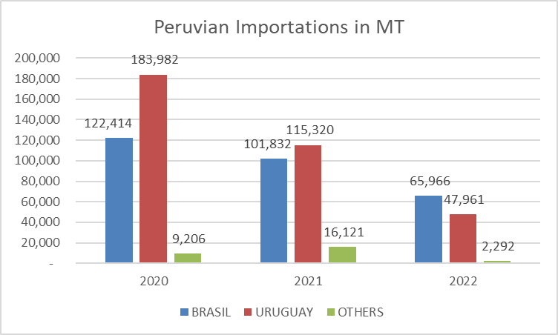
IMPORTATIONS
VARIETY | 2020 | 2021 | 2022 | Total general
Pilled or white | 152,238 | 108,449 | 46,944 | 307,631
Parboiled – Extra | 62,714 | 51,775 | 44,042 | 158,531
Tacuari | 80,471 | 53,998 | 23,298 | 157,767
Others | 20,178 | 19,052 | 1,935 | 41,166
TOTAL | 315,602 | 233,274 | 116,219 | 665,095
IMPORTERS | 2020 | 2021 | 2022 | Total general | %
COSTEÑO ALIMENTOS S.A.C. | 71,332 | 61,316 | 10,898 | 143,546 | 22%
COMERCIAL ISABELITA S.A.C. | 28,623 | 14,950 | 13,848 | 57,421 | 9%
PACIFIC FOODS TRADING S.A.C. | 22,826 | 12,244 | 15,062 | 50,132 | 8%
GRUPO FRAILE RICE S.A.C. | 13,342 | 16,480 | 12,643 | 42,466 | 6%
GRUPO PARCKER'S S.A.C | 18,587 | 13,880 | 8,545 | 41,012 | 6%
NEGOCIACIONES RICE FRAYLECILLO S.A.C. | 14,126 | 15,703 | 6,145 | 35,974 | 5%
OTHERS (125) | 146,765 | 98,701 | 49,078 | 294,544 | 44%
TOTAL | 315,602 | 233,274 | 116,219 | 665,095 | 100%
13

Slide 14
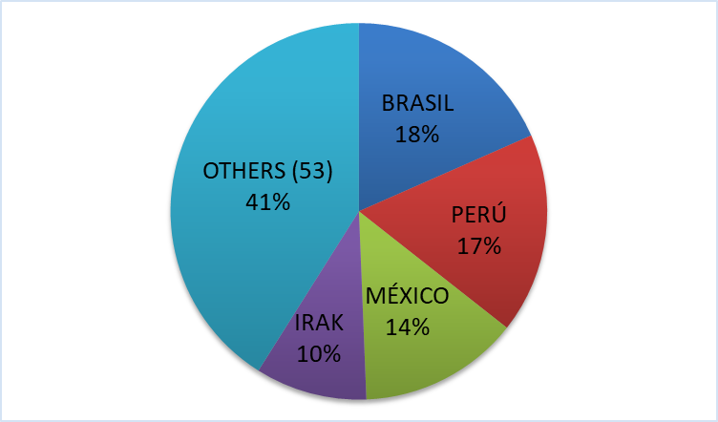
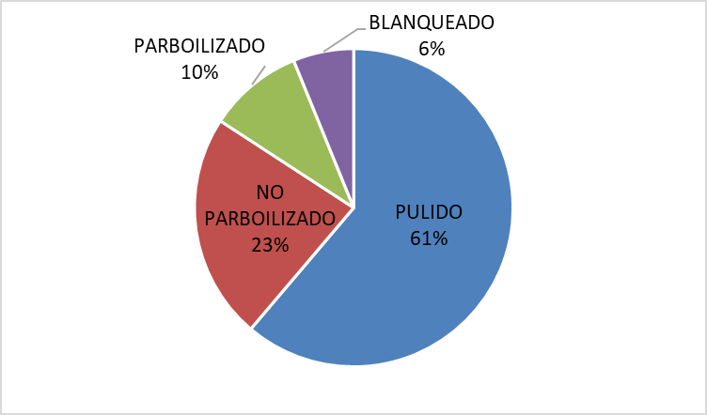
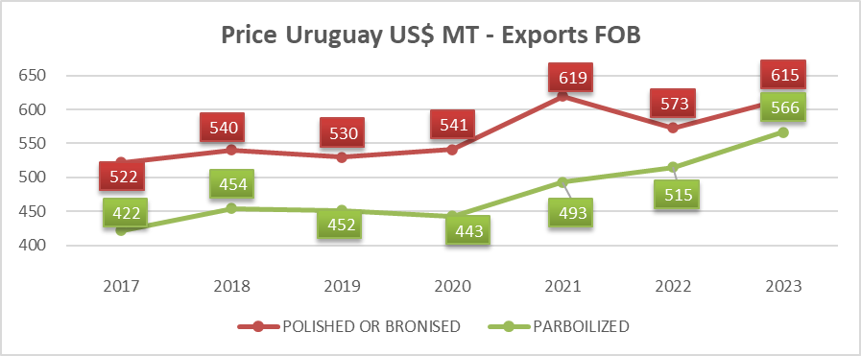
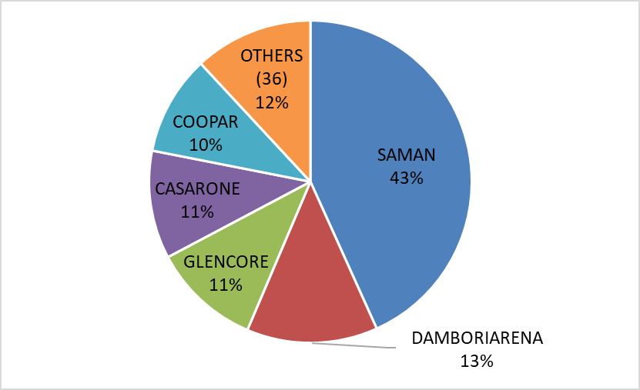
Exportations from Uruguay
Destinations
Varieties
Uruguay exports 900k MT/y
Peru imports 150k-180k MT/y from UY
770k MT/y (84%) is polished and not parboiled rice
Exporters
SAMAN own by the Brazilian company Camil Alimentos exports 400k MT/y (43% Market share)
14

Slide 15
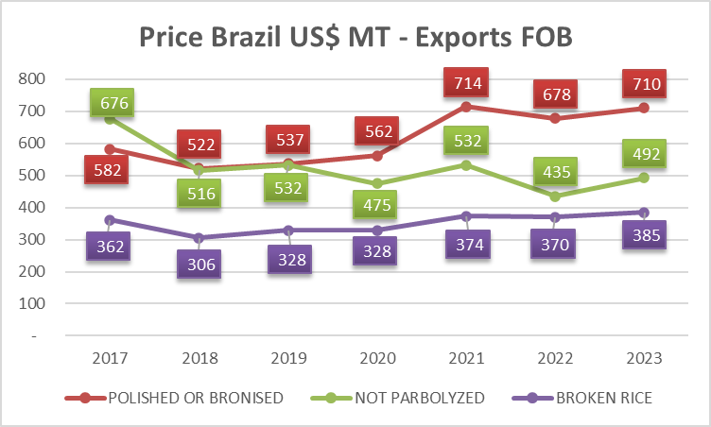
Exportations from Brazil
Destinations
Brazil has covered 154 countries in the 5 contiennts. 31% South America, 28% Africa, 22% Central American countries.
Varieties
Not parbolized: 92% to Central & South America. Btw 400k - 1M tn/y
Broken rice: 78% Africa & 14% Europe. 300k - 400k tn/y
Polished and bronised: 50% South America and 22% Africa. 200k - 350k tn/y
15

Slide 16
Marjorie Nakama
Business Development Manager
+51 976 369 058
Marjorie.nakama@olamagri.com
olamagri.com

